Slide 1










(1) Set Player Roles & Game Elements
(2) Design the CL Gameplay
CL Game Dynamics
Instructional Designer
...
Intelligent Theory-Aware Systems
(3) Interaction
Analysis
Player roles
Game elements

Slide 2
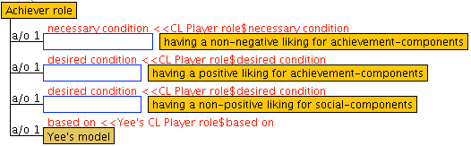
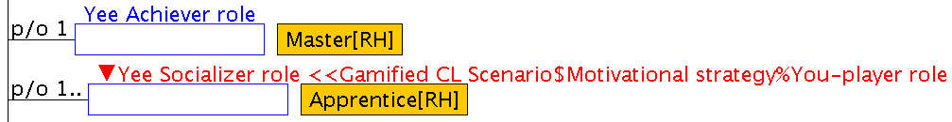

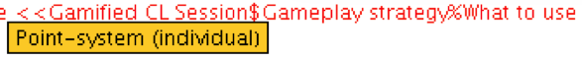
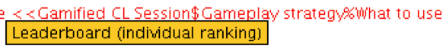
(b)
(a)
(achiever)
(socializer)
POINTS IN THE ACTIVITY
Your points:
You can obtain:
points to elaborate the prob. list
(c)
points to demonstrate how to
solve a problem
RANKING
points
points
points
points
points
points
points
(d)
Show more
ACHIEVEMENTS
Achievements:
Level
of Participation: to attain
points
Level
of Participation: to attain
points
Show more

Slide 3
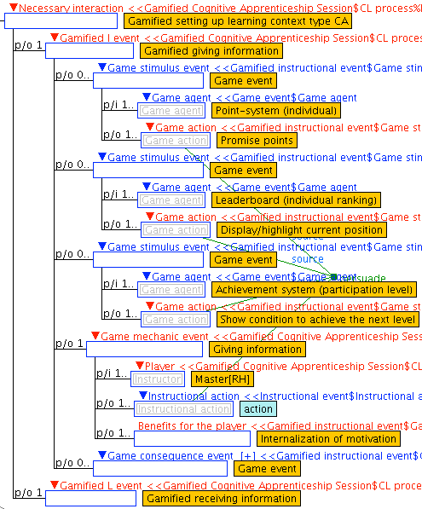
POINTS IN THE ACTIVITY
Your points:
(a1)
You can obtain:
(a3)
points to elaborate the prob. list
points to demonstrate how to
solve a problem
RANKING
points
(b)
points
points
points
points
points
points
Show more
ACHIEVEMENTS
(c)
Achievements:
Level
of Participation: to attain
points
Level
of Participation: to attain
points
Show more
(achiever)
(socializer)
(a2)
4:highest
s(3,y)→s(4,y) 4:highest
+1000 points
S(3,0)
3:high
Anxiety
+800 points
s(2,y)→s(3,y) 3:high
[4;4]
challenge level
s(1,y)→s(2,y) 2:medium
2:medium
+400 points
s(2,y)→s(3,y) 2:medium
S(4,0)
1:low
s(1,y)→s(2,y) 1:low
Boredom
+200 points
0:lowest
s(0,y)→s(1,y) 0:lowest
+100 points
s(0,y)→s(1,y)
s(1,y)→s(2,y)
s(2,y)→s(3,y)
s(3,y)→s(4,y)
transitions in skill development stages

Slide 4
Intelligent theory-aware authoring environment
Player Roles & Game Elements Decision Support System
CL Gameplay Design
Support System
Advice & Recommendation
Instructional Designer
Interaction Analysis
Support System
Gamified CL Sessions
Gamification
Models for CL Scenarios
Persuasive Game Design Strategies (WAY-knowledge base)
Ontology OntoGaCLeS
Maintenance
Gamification Models Manager
Support System
Persuasive Game Design Strategies Manager
Support System
Gamify Expert
Gamification-framework editing environment

Slide 5
(a)
(b)
(2) WAY1
Counter-argue
Being attentive
Action
Being attentive
(1)
Suggestion strategy to be attentive based on PSD
Suggestion strategy to be attentive based on PSD
(4) Applied
(1)
Give suggestion
Receive suggestion
Being attentive
.
Await
Counter-argue
Motivated, Being familiar behavior
(6)
Give suggestion
Focus attention
Being attentive
Await
Action
(3)
Gameplay-stimulus
Gameplay-mechanics
Gameplay-stimulus
Reward strategy to be motivated and to make familiar behavior based on PSD
(5)
Give suggestion strategy by progress bar
(2)
(3) WAY2
Highlight next step
View next step
Has known next step
Promise reward
Raise motivation
Motivated
Give reward
Increase self-behavior
Being familiar behavior
Action
Motivated, Being familiar behavior
Await
Counter-argue
(7) Applied
Gameplay- stimulus
Gameplay-mechanics
Gameplay-consequence
Reward strategy to be motivated and to make familiar behavior based on PSD
(c)
Give reward strategy by points
(8)
(4)
(d)
Give points
Receive points
Has received points
Promise reward
Raise motivation
Motivated
Give reward
Increase self-behavior
Being familiar behavior
Await
Action
(5)
Gameplay- stimulus
Gameplay-mechanics
Gameplay-consequence

Slide 6
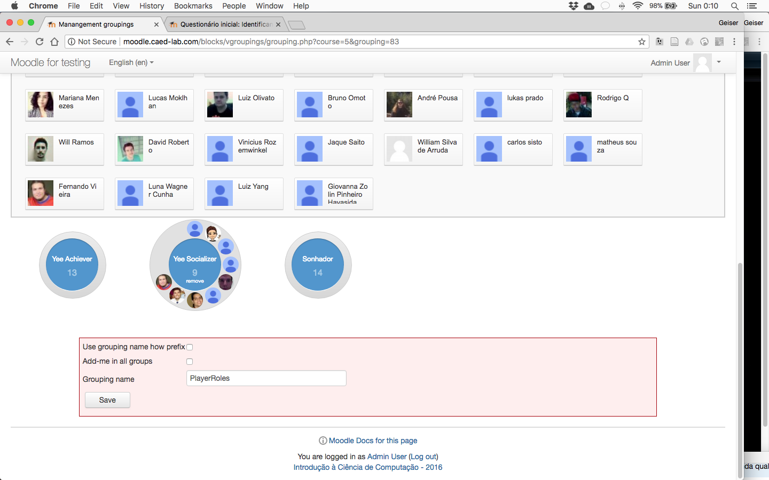
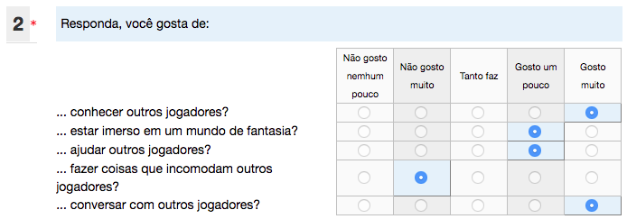
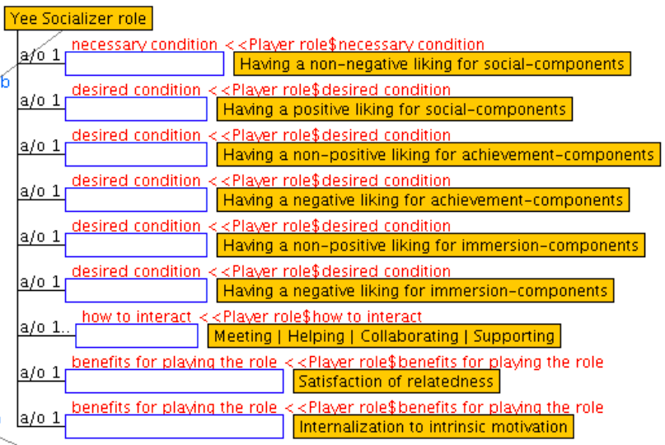

Slide 7
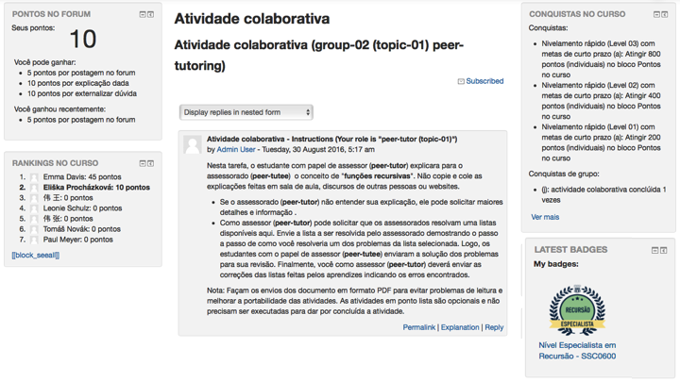
(A)
(C)
(B)
(D)

